Slide 1

Base
2025-2026

Slide 2
We teach a 25 lessons a week
Times of the day
Registration and class reading time | 8.45 – 9.15
Lesson 1 | 9.15 – 10.10
Lesson 2 | 10.10 – 11.05
Break | 11.05 – 11.20
Lesson 3 | 11.20 – 12.15
Lunch | 12.15 – 12.55
Lesson 4 | 12.55 – 1.50
Lesson 5 | 1.50 – 2.40
Buses | 2.40 – 3.00
Teacher/TA Planning Time | 3.00 – 3.30

Slide 3
The curriculum at Bank View School is designed to be broad, balanced and ambitious so that it challenges all learners. It has an emphasis on personal and social development so that students have the resilience to challenge themselves. As a school we are committed to improving life chances for all and we recognise the importance of supporting our students emotional well-being and mental health. Our curriculum is designed and personalised to ensure learners have the knowledge and cultural capital they need to succeed in life
We do this through teaching our students the following skills:
• Self-regulation skills
• Reading skills
• Speaking and Listening/Communication skills
• Independent and Co-operative Thinking and Learning skills
• Life and independence skills including employability skills

Slide 4
On the base curriculum you can find the:
Intent
Implementation and
Impact
Intent refers to what we want our pupils to learn. Implementation is the teaching activities we use to teach our curriculum. The impact is what our pupils have learnt from the curriculum.

Slide 5
The Key Stage 3 classes follow a thematic curriculum, which changes on a termly basis, across a three-year cycle. Most of the foundation subjects, Lifeskills, Science and some of the English lessons are delivered through the theme. The teachers plan an adaptive curriculum, personalised to suit each class and each learner within the class.
Students follow a multi-sensory approach, one which incorporates individual learning styles. The curriculum is enriched by regular outdoor learning opportunities, which are linked to either the termly theme or the development of personal and social skills.
The importance of developing both the students’ academic and social development, means that opportunities to support students in meeting their Educational Healthcare Plan Outcomes are of significant importance. These outcomes will be planned for within the curriculum, and progress towards these will be monitored and tracked.
Planning ensures that no matter what the starting point of the individual pupil, planning is age appropriate and can trace a path to Key Stage 3 programmes of study, where appropriate. Within our bespoke curriculum all Key Stage 3 National Curriculum subjects are taught.
Cultural Capital and Careers
In Base, we recognise that Cultural Capital and Careers are a vital part of our student’s education. Within each planned unit there are identified opportunities for Cultural Capital and Careers.

Slide 6
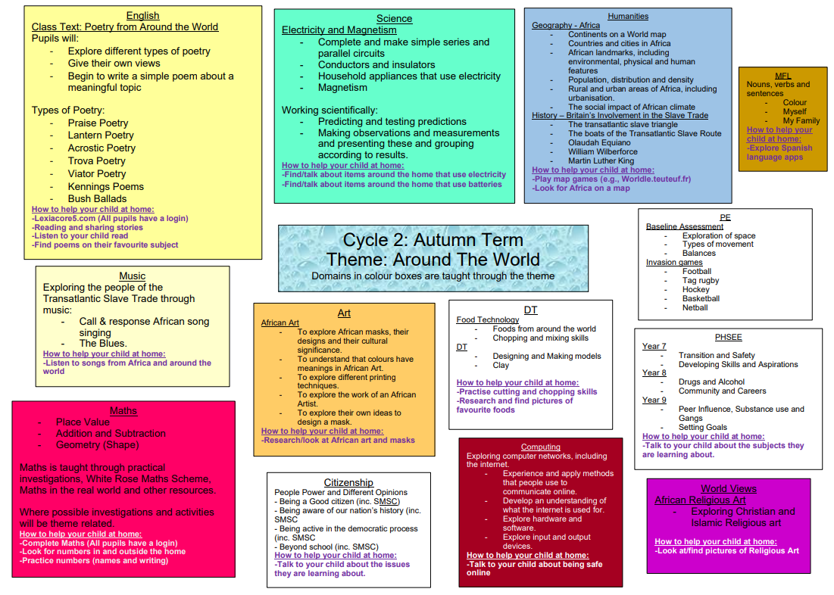

Slide 7
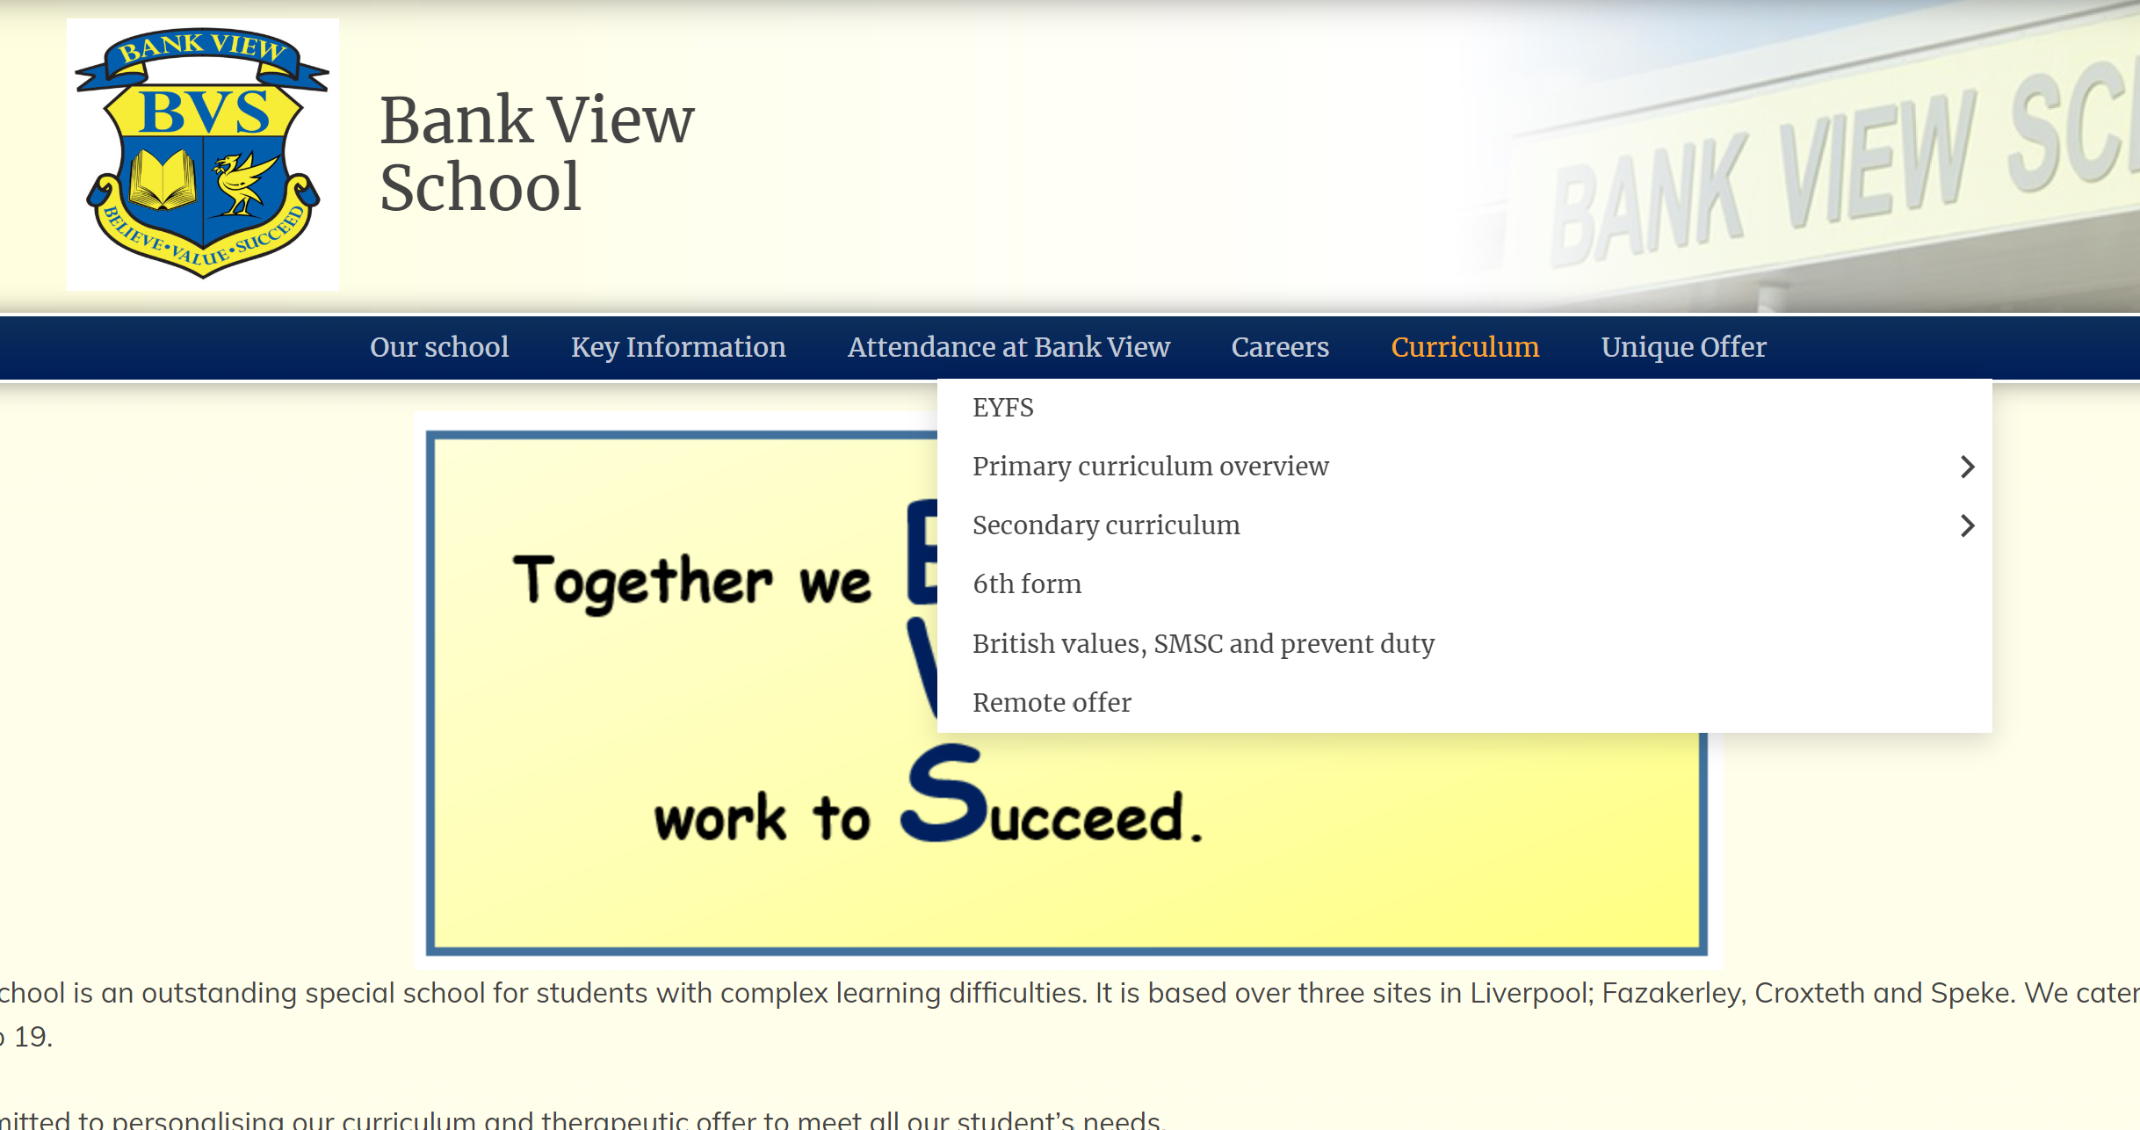
Bank View School – Bank View School (bvhs.co.uk)

Slide 8
Student work towards qualifications at the end of year 11. Pupils study the subjects of English, Maths, Science, PSHEE, World Views, Citizenship, Design and Food Technology and Skills for Further Learning and Employment.
The curriculum is designed in a way to allow for an equal focus to be placed upon academic, personal and social development.
The Key Stage 4 Base curriculum is adapted to meet the needs of the individual students within the provision.
The choice of qualifications allows staff within the Base department to personalise the learning and provide a bespoke curriculum where and when required for individual students.

Slide 9
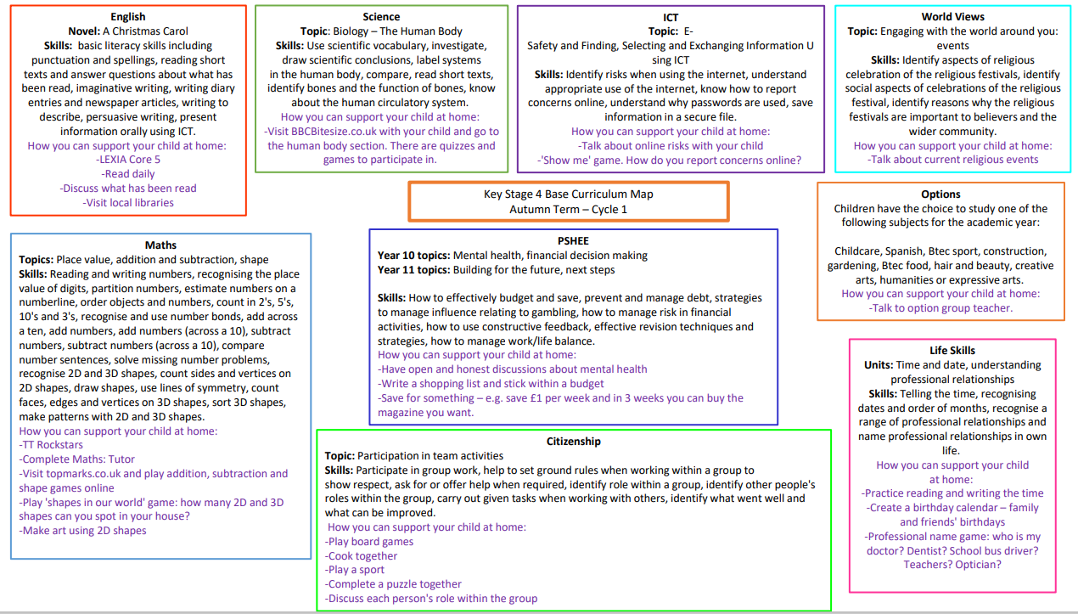

Slide 10
Staff will measure progress with regular checks to ensure students know and remember more from the curriculum.
You will receive a termly report in each subject which shows the progress your child is making in that subject.

